Slide 1


PREDICTION OF CO2 EMISSIONS
FOR COUNTRIES AROUND THE GLOBE
TEAM MET-A-FOUR
Kavya Mannem - 002194057
Sai Srujan Penta - 002928427
Aishwarya Wagdarkar - 002964461
Raveena Lalbahadur Yadav - 002106277

Slide 2

PROBLEM STATEMENT
CO2 Emissions act like a blanket in the air, trapping heat in the atmosphere and warming up the Earth.
This layer prevents the Earth from cooling and thus raises global temperatures.
Global warming would affect environmental conditions, food and water supplies, weather pattern and sea levels.
WHAT WE DID IN THIS PROJECT?
Explored the dataset and evaluated the CO2 emissions for 190 countries.
Forecasted next 15 years data using Linear Regression, Naïve bayes algorithm and Random Forest algorithm.

Slide 3
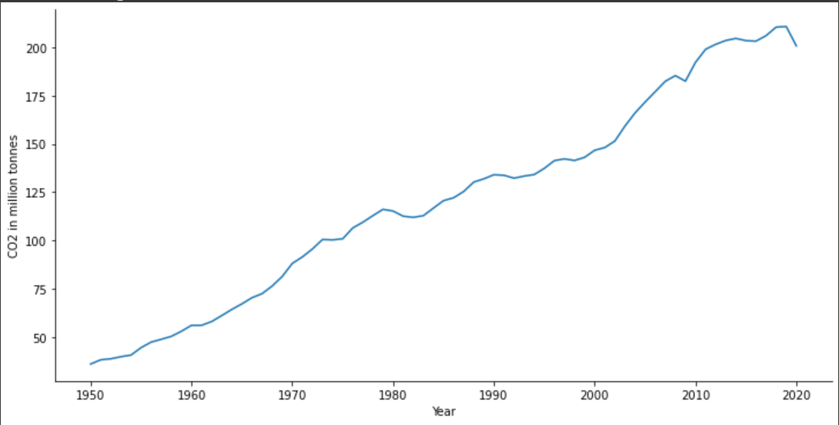
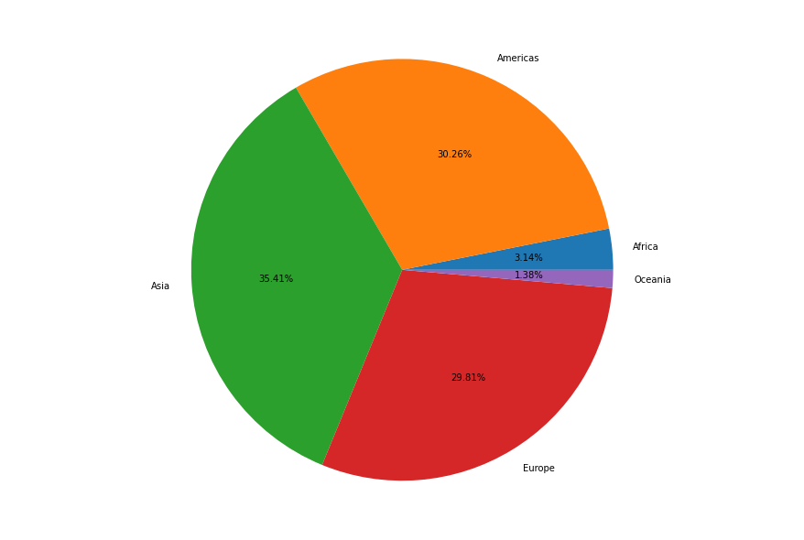
VISUALIZATION
CO2 EMISSIONS OVER THE YEARS (1950-2020)
PERCENTAGE CONTRIBUTION OF CONTINENTS FROM 1950-2020

Slide 4
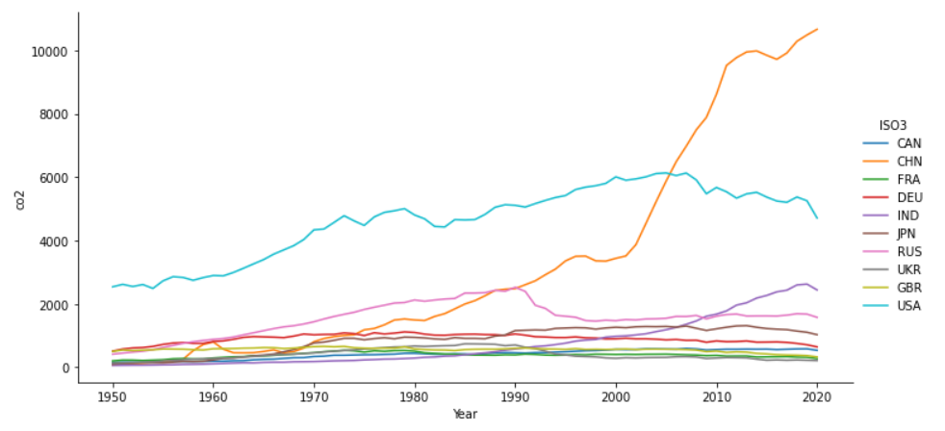
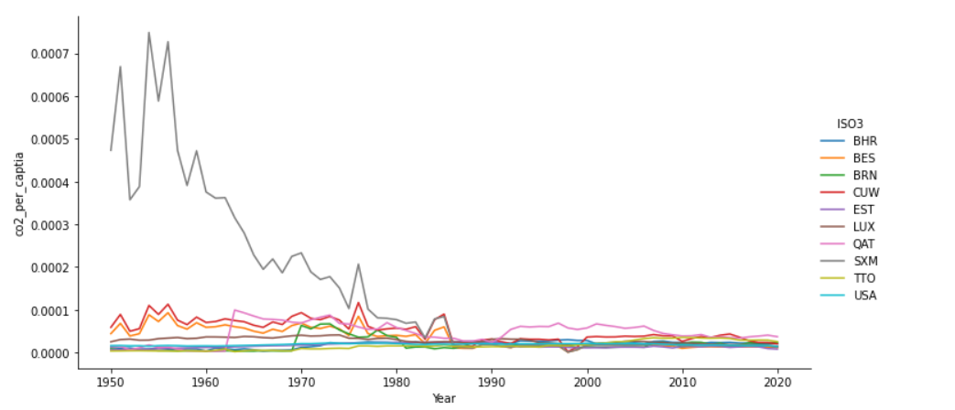
GRAPHICAL REPRESENTAION OF ANALYZED DATA
TOP 10 COUNTRIES IN CO2 EMISSIONS (1950-2020)
TOP 10 EMMITTERS BASED ON PER CAPTIA EMISSIONS

Slide 5
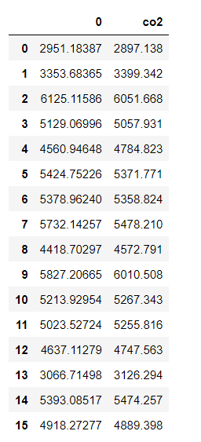
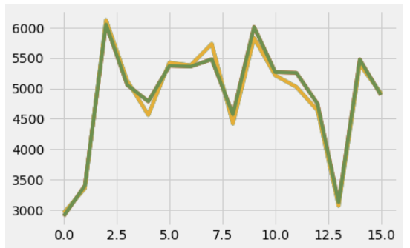
Forecasting next 15 years (2005-2020) data using Random Forest algorithm
Co2 emission predicted for USA Country
O - Predicted Output
Co2 - Actual data from dataset

Slide 6
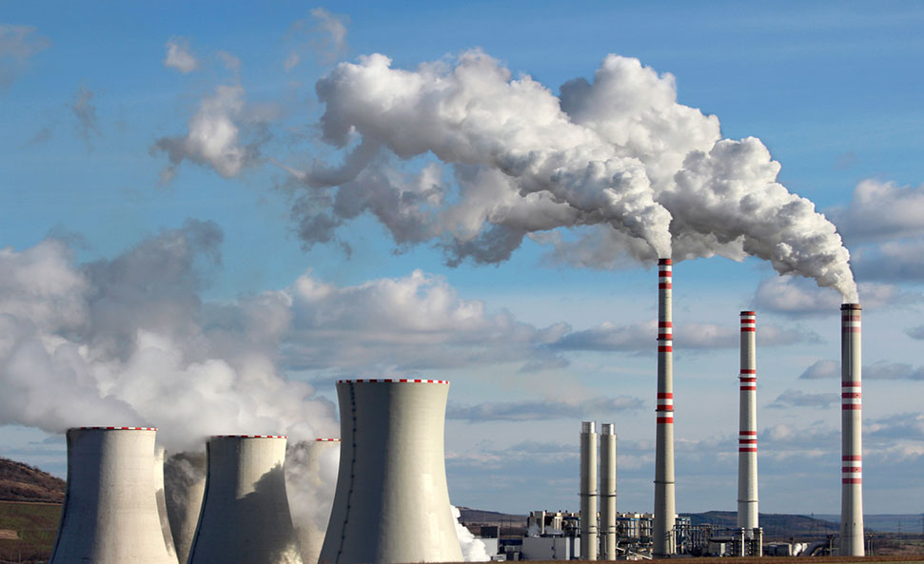


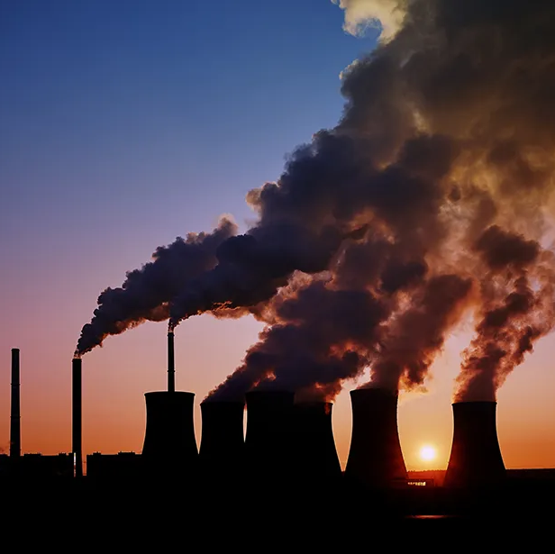
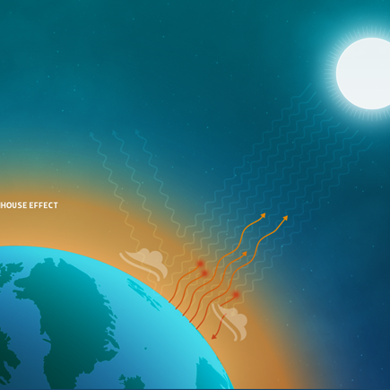
CONCLUSION
According to the percentage change graph for CO2 emissions, the total amount of CO2 emissions across the globe is steadily rising.
If we want to achieve the goals of the Paris Climate Agreement, countries must collectively take action to reduce CO2 emissions. We have employed many strategies to anticipate the data while estimating global CO2 emissions, including categorization techniques and regression models.
Through the use of the Naive-Bayes Classification approach, we were able to achieve RMSE value of 1.232 . Applying several Regression methods, we found that Random Forest had an accuracy of 96%, Linear Regression had a 90% accuracy, Theil Sen Regression had a 64% accuracy, and ARD Regression had an accuracy of 87%.
FUTURE SCOPE
For additional information on pollutants and greenhouse gas emissions, this model can be expanded.
We already have global data visualizations and modelling, thus it would be beneficial to have a customized analysis for each country based on their emission rate.

Slide 7

Thank You

